Slide 1
Atmospheric Loading
Nicole M. Shivers

Slide 2
What is Atmospheric Loading?
“The Earth’s surface is perpetually being displaced due to temporally varying atmospheric oceanic and continental water mass surface loads.” (Van Dam, Plag, Francis, Gegout)
“The unambiguous definition and accurate calculation of a reference pressure is needed in various geodetic applications for global Earth observations.” (Schindellegger, Wijaya, Salstein)

Slide 3
Atmospheric Loading
Main elements required in the computation of loading predictions
1)Earth Model, which determine the geometry, with specific mechanical properties and, if necessary the rheology
2) a mathematical model for the surface load including the boundary conditions at the Earth's surface and the extensions of the load.

Slide 4
There are three components required for determining the load response of the Earth
1) The status of Earth Models
2) the existing surface load data
3) the numerical procedures for preforming the computations themselves

Slide 5
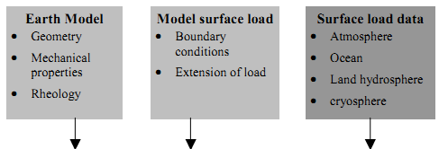
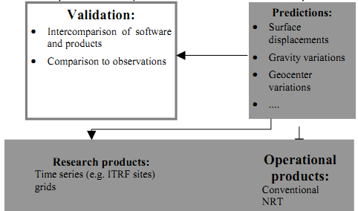
Notes:
Sketch of the scientific and operational loading predictions

Slide 6
Atmospheric Loading
Examples of calculations to create an unambiguous definition and accurate calculations:
to determine Earths deformation due to atmospheric pressure loading include:
Earths time-variable gravity field due to mass atmospheric redistribution
Determination of total atmospheric mass, and seasonal variations
As well as other methods…

Slide 7
Reference Pressure
Existing methods for the definition and calculation of a reference pressure.
Gridded pressure data from Numerical Weather Model (NMW)
Long term average of surface pressure data (Petrov and Boy, 2004)
Reduced reference pressure at the topographic height (Plag et al., 2007)
Reduced reference pressure at the mean height of a cell with pre-defined size (Schuh et al., 2009)
Analytical functions
Berg model (Berg, 1948)
UNB model (Leandro et al., 2006)
Global Pressure and Temperature (GPT) model (BÄohm et al., 2007)
Notes:
NMW: The NMW determines the reference pressure value at any site by averaging and interpolating global pressure data from NWM
Analytical Functions
Berg Model: provide a way to calcualte reference pressure vlaues by simply entering the position of a site to the functions.
The recommendations for the definition of a reference pressure are summarized as follows:
A reference pressure should be unambiguously determinable now and the same pressure values should
be obtained at any time in the future.
b. Any developed method for a reference pressure should be as simple as possible but accurate enough for
present day requirements de¯ned within the Global Geodetic Observing System (GGOS) of the IAG,
i.e. 1 mm position accuracy and 0.1 mm/yr velocity accuracy.
c. A reference pressure should be accompanied by information about its corresponding height.
d. A reference pressure should cause no (or only small) biases compared to previous results, i.e. to analyses
which did not refer to a reference pressure. For instance, if the reference pressure is more accurate
than 2 hPa, the resulting height bias would be less than 0.6 mm, which is certainly acceptable in all
areas (see also requirement b). The value of 0.6 mm is derived by assuming the average value of the
regression coe±cient, i.e. 0.3 mm/hPa (Rabbel and Zschau, 1985).
Analytical Functions

Slide 9
Atmospheric Pressure
The reference pressure values have been usually determined by averaging global daily surface pressure data for a certain period, 1 to 2 years of ECMWF (European Centre for Medium-range Weather Forecasts)
Or 22 years of NCEP (National Center for Environmental Prediction)

Slide 10
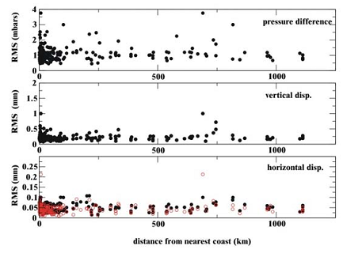
Notes:
RMS differences between deformations predicted using ECMWF
and NCEP pressure data

Slide 11
Atmospheric Loading on the Ocean
Atmospheric loading on the Ocean describes the ocean’s response to atmospheric pressure and the inverted barometer correction.
The National Meteorological Center (NMC) global pressure
The second difference between the inverted barometer response and the complete equilibrium response is due to gravitational forcing by the atmosphere and by the displaced mass in the solid Earth and oceans caused by atmospheric loading.
Notes:
NMC: is used to estimate the time-dependent, average change in pressure over the oceans.
It contains an annual signal with a peak-to-peak amplitude of 1.2mbar superimposed on a linear trend of 0.09 mbar yr⁻¹
The second difference is largest within about 1000km of the coast and at high latitudes. The NMC pressure data is used to estimate the effect, and find that is causes differences form the inverted barometer solution in the regions of up to 10-30 mm peak-to-peak, with values as larges as 50-60mm possible at certain locations.

Slide 12
The geoid is not constant with time, satellites such as LAGEOS have identified secular as well as seasonal variations over an extended period of time.
The geoid is not constant with time, the variability is most likely due to some combination of postglacial rebound and changes in polar ice mass
The seasonal fluctuations are likely due mostly to the redistribution of atmospheric mass occurring at longer wavelengths.

Slide 13
Atmospheric Loading
There are three sum terms, to determine the geoid variability due to the atmosphere are:
1) an inverted barometer (IB) response of about 10mm of sea-surface depression for every 1 mbar increase in atmospheric pressure
2) The equilibrium response of the ocean to gravitational forcing from the atmosphere and from the displaced mass in the solid Earth and oceans caused by the atmospheric loading
3) A spatial constant that must be added to the solution to conserve oceanic mass

Slide 14
Atmospheric Loading
Effects of the inverted barometer is routinely removed from altimeter and tide-gauge sea-level data.
Effect two is equivalent to the geoid perturbation
And Effect three will be discussed in mathematical terms.

Slide 15
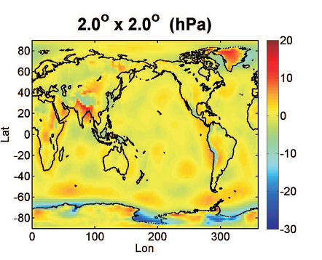
Notes:
Figure 1: Deviation of reference pressure values determined by the GPT model and the block-mean method
(GPT minus block-mean). The latter will be described in Section 3.

Slide 16
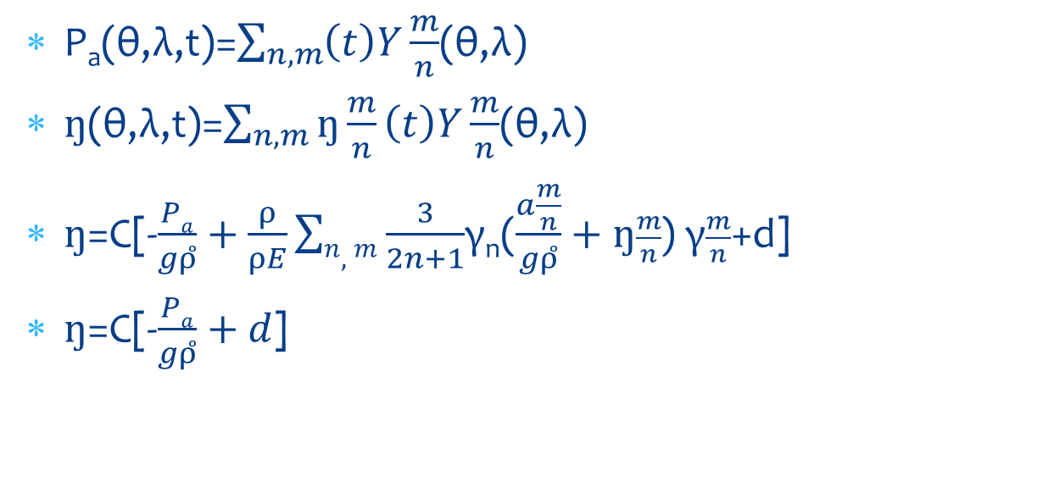
Atmospheric Loading
P_{a}(θ,λ,t)=$\sum_{n,m}{\left(t\right)Y}\frac{m}{n}$(θ,λ)
$ŋ$(θ,λ,t)=$\sum_{n,m}{ŋ\frac{m}{n}}\left(t\right)Y\frac{m}{n}$(θ,λ)
$ŋ$=C[-$\frac{Pa}{gρ̊}+\frac{ρ}{ρE}\sum{n,m}\frac{3}{2n+1}$γ_{n}($\frac{a\frac{m}{n}}{gρ̊}+ŋ\frac{m}{n}$) γ$\frac{m}{n}$+d]
$ŋ$=C[-$\frac{Pa}{gρ̊}+d$]

Slide 17
Atmospheric Loading
Results for the average atmospheric pressure over the entire globe (oceans + continents) indicate that there is an annual term and trend in the global results
The observed change is the average atmospheric pressure over the oceans is due mostly to a redistribution of atmospheric mass between the continents and oceans, rather than to an actual charge in the total mass of the atmosphere
Notes:
Oceans + continents are both smaller than their corresponding terms in the atmospheric pressure over the oceans (peak-to-peak annual amplitude and the trend are .5mbar and -.03 mbar yr⁻¹ for the global average)

Slide 18
Atmospheric Loading
The results are largest near the coast, where as much as 50-60mm deformation has been seen in a few places.
The results are especially large at high latitudes, due presumably to the larger pressure variability there.

Slide 19
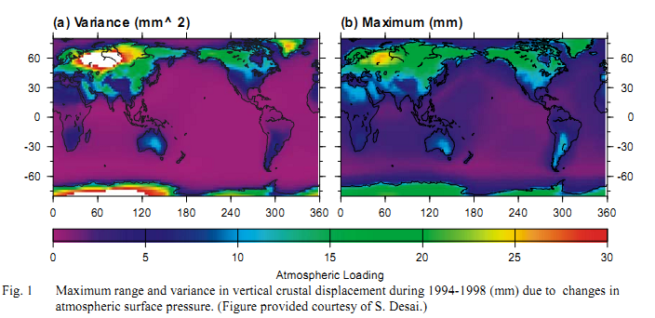
Atmospheric Loading
Notes:
Maximum range and variance in vertical crustal displacement during 1994-1998 (mm) due to changes in
atmospheric surface pressure. (Figure provided courtesy of S. Desai.)

Slide 20
Atmospheric Loading
The effects of non-tidal loading are tyically 5mm, peak-to-peak, for vertical motion near the coast with upto 10mm possible; with corresponding chages in gravity being up to 5 μGal

Slide 21
References
Atmospheric pressure corrections in geodesy and oceanography: A strategy for handling air tides, Ponte, Rui M., Ray, Richard D., Geophysical Research Letters, Vol. 29, NO, 24, 2153
Memo: A method for the definition of global reference pressure; Schindelegger, Schuh, M., Wijaya, D.D., Bohm, J., Salstein
Predictions of crustal deformation and of geoid and sea-level variability caused by oceanic and atmospheric loading; vanDam, T.M., Wahr, J., Leuliette, Geophys, J, Int (1997) 129, 507-517
GCFC Special Bureau for Loading: Current Status and Plans; VanDamm, T., Plag, H-P., Francis, O., Geogout, P., IERS Technical Note No 30

