Slide 1
Brief Introduction to Geomagnetic Phenomena: Relationship to Geodesy and Modern Infrastructure
Eric Kiefer
Geol 495/ Hans-Peter Plag
Spring 2011
University of Nevada, Reno

Slide 2
History of Geomagnetics
Properties of lodestone (magnetite) were known to ancient Greeks and Chinese
Earliest by Greek philosopher Thales in sixth century B.C.
Chinese literature between third century B.C. and sixth century A.D. full of references to magnets, but nothing as far back as Thales (Needham, 1962)
Usual name for magnet, ci shi, the “loving stone”; can be compared to French word aimant.
Earliest known form of magnetic compass was invented by the Chinese by at least the first century A.D. and probably as early as the second century B.C. (Needham, 1962)
Composed of lodestone spoon rotating on a smooth board
Given thermoremanent magnetization by heating and cooling through Curie Point while set in N-S orientation; able to overcome friction
Subsequent models of the compass improved drag by inventing floating, dry pivoted, and silk or other fiber suspended versions (Merrill, 1996)

Slide 3
History, cont’d…
Declination
First observed in China by Buddhist astronomer Yi-Xing about A.D. 720 (Needham, 1962); at least 9 measurements from A.D. 720-1280
Knowledge did not travel with the compass; first discovery in Europe appears to be by Georg Hartmann (a Vicar of Nurenberg), made in Rome in 1510 A.D.
Strong evidence that declination was at least known in Europe by early 1400s, even if precise measurements were not recorded for another century.
Inclination
Discovered by Georg Hartmann in 1544, as mentioned in a letter of that year
Letter was discovered in the Konigsberg archives in 1831, so his discovery had no influence on studies of the Earth’s Magnetism
Rediscovered by English hydrographer, Robert Norman, in 1576
No record of any discovery of inclination by Chinese

Slide 4
History, cont’d…
Secular Variation
Studies of secular variation in the past using fossil magnetizations first attempted by Chevalier (1925), using lava flows on Mount Etna
Use of archaeomagnetic techniques on baked hearths/pottery detailed by Thellier and Thellier (1951,1952) in France
By Cook and Belshé (1958) in England
First attempt at determining recent secular variation from sediments was made by Johnson (1948) in the United States on New England varved sediments covering ~5,000 yr. time span, more than 10,000 yrs. ago.
Similar attempt using Swedish varved clays made by Griffiths (1953)
Development of a portable core sampler for lake deposits (Mackereth, 1958) saw start of extensive studies of lake sediments for obtaining prehistoric records of secular variation

Slide 5
Magnetosphere
A magnetosphere is formed when a stream of charged particles, such as solar wind, interacts with and is deflected by the intrinsic magnetic field of a planet or similar body
Earth’s magnetosphere is a region in space whose shape and behavior is determined by:
The Earth's internal/intrinsic magnetic field
The solar wind (solar wind plasma)
The interplanetary magnetic field (IMF)
In the magnetosphere, a mix of free ions and electrons from both the solar wind and the Earth's ionosphere is confined by electromagnetic forces that are much stronger than gravity and collisions.
Despite its name, the magnetosphere is distinctly non-spherical
All known planetary magnetospheres in the solar system possess more of an oval tear-drop shape because of the solar wind

Slide 6
Magnetosphere

Slide 7
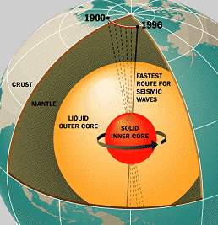
Magnetosphere: Dynamo Theory
“Intrinsic” magnetic field of Earth is thought to be caused by a Dynamo effect in a complex interaction of the liquid outer core with the solid inner core and plastic mantle regions of the Earth during its rotation
Dynamo theory describes the process through which a rotating, convecting, and electrically conducting fluid acts to maintain a magnetic field. This theory is used to explain the presence of anomalously long-lived magnetic fields in astrophysical bodies
The conductive fluid in the geodynamo is liquid iron in the outer core
Three conditions are needed for a dynamo to function:
An electrically conductive fluid medium
Kinetic energy provided by planetary rotation
An internal energy source to drive convective motions within the fluid
Rotation in the outer core is supplied by the coriolis effect caused by the rotation of the Earth. The coriolis force tends to organize fluid motions and electric currents into columns aligned with the rotation axis.

Slide 8
Magnetosphere: Induction Equation
Induction of the magnetic field is described by the induction equation:
$\frac{∂H}{∂t}=\frac{1}{σμ_{0}}∇^{2}H+∇×(v×H)$
Where $v$ is velocity, H is magnetic field, t is time, $\frac{1}{σμ_{0}}$ is the magnetic diffusivity where σ is the electrical conductivity and μ is permeability
The ratio of the second term on the right hand side to the first term gives the Magnetic Reynolds number, a dimensionless ratio of advection of magnetic field to diffusion

Slide 9
Magnetosphere

Slide 10
Magnetosphere
On the side facing the Sun, the distance to its boundary (which varies with solar wind intensity) is about 70,000 km (10-12 Earth radii or R_{E}, where 1 R_{E} = 6371 km; unless otherwise noted, all distances here are from the Earth's center).
The boundary of the magnetosphere ("magnetopause") is roughly bullet shaped, about 15 R_{E} abreast of Earth and on the night side (in the "magnetotail" or "geotail") approaching a cylinder with a radius 20-25 R_{E}.
The tail region stretches well past 200 R_{E}, and the way it ends is not well-known.
The outer neutral gas envelope of Earth, or geocorona, consists mostly of the lightest atoms, hydrogen and helium, and continues beyond 4-5 R_{E}, with diminishing density
The upward extension of the ionosphere, known as the plasmasphere, also extends beyond 4-5 R_{E} with diminishing density, beyond which it becomes a flow of light ions called the polar wind that escapes out of the magnetosphere into the solar wind
Energy deposited in the ionosphere by auroras strongly heats the heavier atmospheric components such as oxygen and molecules of oxygen and nitrogen, which would not otherwise escape from Earth's gravity

Slide 11
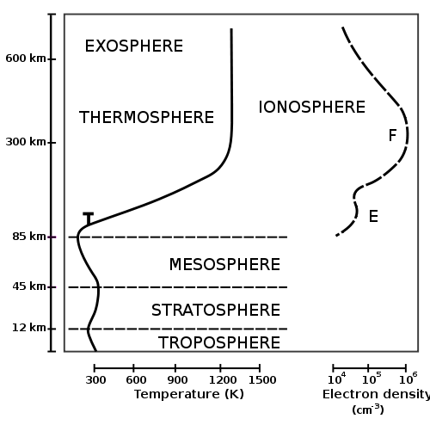
Ionosphere
The ionosphere is a part of the upper atmosphere, comprising portions of the mesosphere, thermosphere and exosphere
Distinguishable because it is ionized by solar radiation
It is a significant part in atmospheric electricity and forms the inner edge of the magnetosphere
It has practical importance because, among other functions, it influences radio propagation to distant places on the Earth
The ionosphere is a shell of electrons, and electrically charged atoms and molecules that surrounds the Earth, stretching from a height of about *50 km to more than *1000 km
It owes its existence primarily to ultraviolet radiation from the sun
* these figures are highly dependent on current conditions, and so are highly variable in time and space
The Ionosphere is composed of several layers

Slide 12
Ionospheric Layers: D Layer
The inner most layer (*60 km to *90 km above Earth’s surface)
Ionization here is due to Lyman series-alpha hydrogen radiation at a wavelength of 121.5 nm ionizing nitric oxide (NO); In addition, with high Solar activity hard X-rays (wavelength < 1 nm) may ionize (N₂, O₂).
Recombination is high in the D layer, the net ionization effect is low, but loss of wave energy is great due to frequent collisions of the electrons (about ten collisions every msec). As a result high-frequency (HF) radio waves are not reflected by the D layer but suffer loss of energy therein. This is the main reason for absorption of HF radio waves, particularly at 10 MHz and below, with progressively smaller absorption as the frequency gets higher
The absorption is small at night and greatest about midday. The layer reduces greatly after sunset; a small part remains due to galactic cosmic rays
A common example of the D layer in action is the disappearance of distant AM broadcast band stations in the daytime.

Slide 13
Ionospheric Layers: E Layer
The E layer is the middle layer (*90 km to *120 km above the surface of the Earth)
Ionization is due to soft X-ray (1-10 nm) and far ultraviolet (UV) solar radiation ionization of molecular oxygen (O₂)
Normally, at oblique incidence, this layer can only reflect radio waves having frequencies lower than about 10 MHz and may contribute a bit to absorption on frequencies above
However, during intense Sporadic E events the E_{s} layer can reflect frequencies up to 50 MHz and higher
The vertical structure of the E layer is primarily determined by the competing effects of ionization and recombination
At night the E layer rapidly disappears because the primary source of ionization is no longer present
After sunset an increase in the height of the E layer maximum increases the range to which radio waves can travel by reflection from the layer
This region is also known as the Kennelly-Heaviside Layer or simply the Heaviside layer

Slide 14
Ionospheric Layers: $E_{s}$ Layer
The E_{s} layer (sporadic E-layer) is characterized by small, thin clouds of intense ionization, which can support reflection of radio waves, rarely up to 225 MHz
Sporadic-E events may last for just a few minutes to several hours
There are multiple causes of sporadic-E that are still being pursued by researchers
Sporadic E propagation occurs most frequently during the summer months when high signal levels may be reached
This propagation makes radio amateurs very excited, as propagation paths that are generally unreachable can open up
The skip distances are generally around 1000 km (620 miles). Distances for one hop propagation can be as close as 900 km [500 miles] or up to 2500 km (1,400 miles). Double-hop reception over 3500 km (2,000 miles) is possible.

Slide 15
Ionospheric Layers: F Layer
The F layer or region, also known as the Appleton layer, extends from about *200 km to more than *500 km above the surface of Earth
It is the densest part of the ionosphere, which implies signals penetrating this layer will escape into space
Beyond this layer is the topside ionosphere
Here extreme ultraviolet (UV, 10–100 nm) solar radiation ionizes atomic oxygen
The F layer consists of one layer at night, but during the day, a deformation often forms in the profile that is labeled F₁
The F₂ layer remains by day and night responsible for most skywave propagation of radio waves, facilitating high frequency (HF, or shortwave) radio communications over long distances
From 1972 to 1975 NASA launched the AEROS and AEROS B satellites to study the F region

Slide 16
Ionospheric Layers

Slide 17
Ionosphere: Anomalies and Perturbations
Anomalies
Winter Anomaly
Equatorial Anomaly
Equatorial Electrojet
Perturbations
X-rays: Sudden Ionospheric Disturbances (SID)
Protons: Polar Cap Absorption (PCA)
Geomagnetic Storms
Lightning

Slide 18
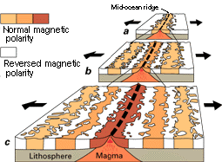
Pole Reversals
A change in the geomagnetic field such that the positions of magnetic north and magnetic south become interchanged
Throughout Earth’s history the magnetic field has switched between periods of normal and reverse polarities; these periods are deemed “chrons”
Currently in a normal chron; i.e. magnetic lines travel out of magnetic south and into magnetic north
Happen randomly as a result of functions in the Earth’s Dynamo
May also be possible to “trigger” reversals through external stimuli; e.g. meteor or cometary impact, subducting slabs, melting ice caps, etc.
Chrons vary in length from < 10,000 years to > 50 million years, but they average around 300,000 years
Last reversal occurred 780 Ka, Brunhes-Matuyama reversal
Pole reversals are estimated to last a few thousand years (1,000-10,000)
During that time the magnetic field does not disappear completely but may be mildly to severely weakened

Slide 19
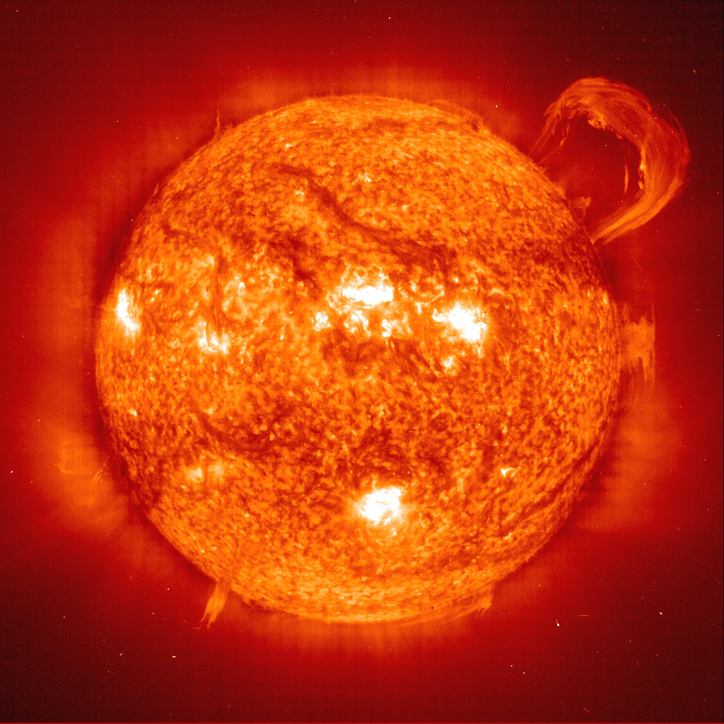
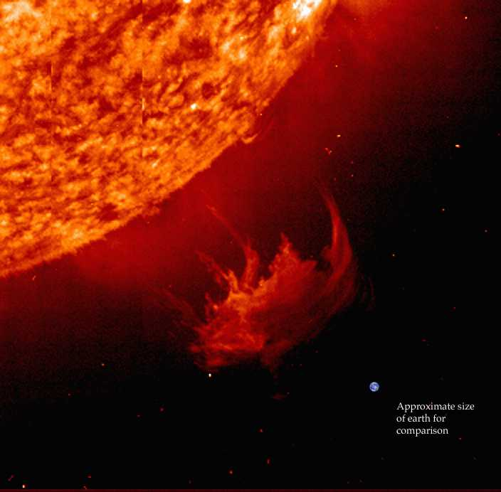
Geomagnetic Storms
A magnetic storm is a period of rapid magnetic field variation
Generally caused by one of two variations in space and the Earth-Sun Relationship
Causes complex oscillations and disturbances in the magnetosphere
Coronal Mass Ejections (CME)
By far the most common cause of magnetic storms
A CME is a “burst” of plasma out of the Sun (can be billions of tons of material)
Often associated with solar flares and prominence eruptions; but they can occur independently
Frequency of CMEs varies with the sunspot cycle (11/22-year cycle)
Solar Minimum: NASA observes about 1 CME per week
Solar Maximum: NASA observes an average of 2 to 3 CMEs per day

Slide 20
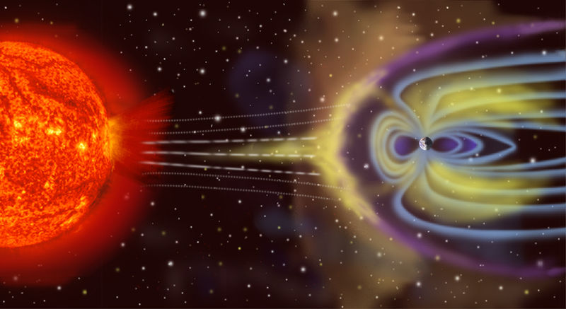
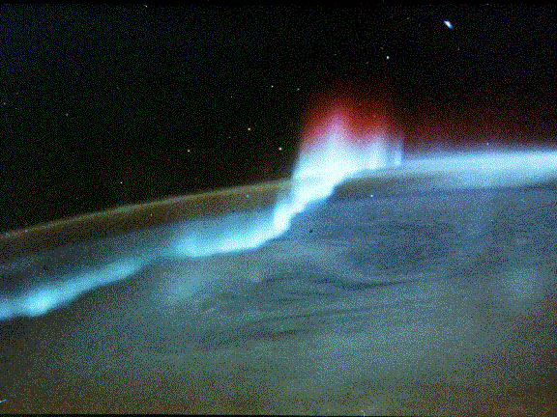
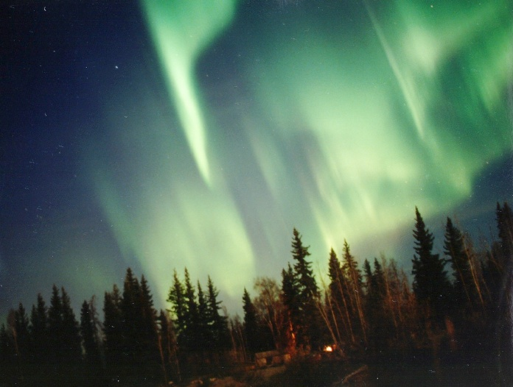
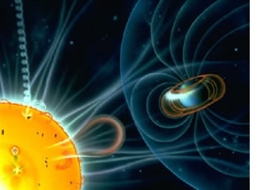
Geomagnetic Storms
On rare occasions, the magnetic field of the Sun directly links with the magnetic field of Earth
Not the normal state of affairs
When it occurs, charged particles travelling along magnetic field lines can easily enter the magnetosphere, generate currents, causing a time-dependent variation in the magnetic field
Occasionally it is possible for the Sun to emit a CME while the magnetic field lines of the Sun and Earth are in direct connection
This results in a truly large and awesome magnetic storm on Earth
During a Magnetic storm the extent of the magnetosphere that faces the Sun may be reduced by up to half
Plasma can generate its own magnetic field; this is a contributing factor in the complex Storm-Substorm relationship
In which magnetic storms, themselves, often cause substorms to occur

Slide 21
Effects on Geodesy
Many geodetic satellite systems (such as GPS, LORAN, etc.) broadcast their signals via Radio Waves
This means that depending on how the ionosphere is behaving, signals may be blocked or refracted, which can severely degrade the signals, leading to error
Ionospheric layers behave very differently during and immediately after magnetic storms
Complete jamming of radio signals is possible when any ground station is in complete alignment with the Sun and a target (e.g. a satellite, an airplane, etc.) if appropriate ionospheric conditions are present
Solar storms cause volume and density changes in the Earth’s atmosphere
This leads to changes in satellite orbits; if they are not constantly corrected for, satellites can re-enter Earth’s atmosphere and burn up
The Maunder Minimum (a period of low Sun activity in the late 17th century) correlates with the “Little Ice Age” climatic phenomenon
This suggests there may be a correlation between solar activity and terrestrial climate; this is an area of on-going scientific investigation
This connection (if true) also suggests there are complex inter-planetary interactions acting upon the Earth that we do not fully understand or appreciate; or even know about

Slide 22
Effects on Geodesy
Ionosphere leaves artifacts imbedded in many measurements aimed at the surface of the Earth
These artifacts must be accurately identified and filtered in order to reduce error
Constant fluctuations (both locally and temporally) often make this an arduous task
Local perturbations and anomalies in the ionosphere can change the data collected at different times, even in the same location with the same instruments
Secular variation and polar wandering dictates that scientists must be constantly monitoring changes in and accurately mapping locations of magnetic poles and isomagnetic lines
Absolutely necessary for getting accurate readings and reducing error

Slide 23
Geomagnetic Storms and Infrastructure
Communication
Long-haul telephone lines (even under-sea cables) can be disrupted (unless they are fiber-optic)
Many communication systems use the ionosphere to reflect radio signals over long distances
Some frequencies are absorbed, while others are reflected; resulting in sporadic and fluctuating signals, and unexpected propagation paths
Signals below 30 MHz are often disrupted, e.g. ground-to-air, ship-to-shore, shortwave broadcast, and amateur radio (HF signals like TV, and commercial radio are usually little affected)
Some military early warning systems can be affected by solar activity
“over-the-horizon radar” bounces signals off the ionosphere to monitor for the launch of aircraft or missiles from long distances; greatly hampered or lost from radio clutter
Some submarine detection systems use magnetic signatures of submarines as one input in their locating scheme; signals become distorted or missed due to fluctuations
Jamming of air-control radio signals can occur
As mentioned before: if aircraft or satellites are in alignment with the Sun
Damage to communications satellites can disrupt non-terrestrial telephone, television, radio, and internet links

Slide 24
Geomagnetic Storms and Infrastructure
Navigation
GPS, LORAN, OMEGA (now-defunct) are affected by disrupting signal propagation
GPS signals affected by rapid density changes in ionosphere
Causes signals to scintillate (like a twinkling star)
Receiver Autonomous Integrity Monitoring (RAIM); developed to try to deal with conflicting or confusing signals
Assumes majority of satellites in GPS constellation are unperturbed
If majority of GPS constellation is perturbed (e.g. during a magnetic storm) then readings are still unreliable
Pipelines
Rapidly fluctuating magnetic fields can produce geomagnetically induced currents in the pipelines
Flow meters in the pipeline can transmit erroneous flow information
Corrosion rate of the pipeline is dramatically increased

Slide 25
Geomagnetic Storms and Infrastructure
Satellite Hardware Damage
Magnetic storms (increased solar ultraviolet emission) increases the volume and density of ionosphere, increasing drag
Low-orbit satellites are especially at risk; must constantly be corrected or they will return to, and burn up in, Earth’s atmosphere (i.e. “Skylab”, circa 1979)
Vulnerability of satellite also depends on position
Location, location, location; South Atlantic Anomaly (SAA) is perilous for satellites
Technology has allowed for miniaturization of spacecraft components, but the smaller the systems become the more susceptible they are to energetic solar particles
Can physically damage microchips, or even change software commands
Energized particles striking the spacecraft can cause differential charging
Eventually can lead to electrical discharge arcing across components: harming or even disabling them
Bulk charging (aka deep charging) can also result from collisions with charged particles (primarily electrons)
Penetrate outer covering and deposit charge in inner parts
If sufficient charge builds up in one component, it may discharge to another in an attempt to neutralize; this discharge is potentially hazardous to onboard electronic systems

Slide 26
Geomagnetic Storms and Infrastructure
Electric Grid
Geomagnetically induced currents occur on a grand scale during geomagnetic storms on all long transmission lines
Any power companies utilizing long transmission lines (many km in length) are at risk (mainly operators in China, North America, Australia)
European grid often utilizes shorter transmission cables; less vulnerable
The (nearly direct) currents induced are harmful to electrical transmission equipment, especially to generators and transformers
Induces core saturation, constraining their performance (and trips many safety devices), and causes coils and cores to heat up
This heat can disable or destroy them, even causing a chain reaction that can overload and blow transformers in an entire system (e.g. Québec; March 13, 1989)
Using geomagnetic storm warnings power companies can (and often do) minimize damage to power transmission equipment by momentarily disconnecting transformers or initiating temporary blackouts

Slide 27
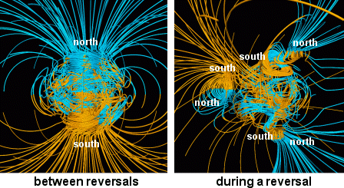
Possible Effects of a Pole Reversal in Modern Times
Recap: Geomagnetic pole reversals take thousands of years to manifest
During which, the field does not disappear; but may be weakened
Magnetic force lines on Earth’s surface become extremely complicated
Force lines become twisted; poles become numerous and arbitrarily positioned
The system is in dynamic flux
Many poles manifesting and disappearing
Force lines snapping, twisting, and unsnapping
A system in flux may be much more susceptible to outside influence, i.e. solar magnetosphere, or the IMF
If the magnetosphere is weakened, Earth (and therefore infrastructure) becomes much more susceptible to adverse affects from geomagnetic storms

Slide 28
Possible Effects of a Pole Reversal in Modern Times
There is no uncontested evidence for a correlation between a magnetic pole reversal and any notable extinction rates, let alone a mass extinction event.
And indeed, Human ancestors survived several reversal events
However, no other creatures on Earth have ever utilized (and become dependent on) electronics or computers in everyday life
e.g. Dinosaurs did not surf the web in their spare time, nor did Trilobites depend on satellites for navigation, nor did Wooly Mammoths communicate with one another via radio signals
Which means that besides a handful of organisms (mainly marine, i.e. sea turtles, dolphins, whales, etc.) that use the magnetosphere as a means of navigation (as species they have been surviving for millions of years which means CLEARLY they have adapted to and overcome MANY reversal events), modern Humans are in a unique position, in that they could be the first species on Earth that could be COMPLETELY affected by a magnetic pole reversal

Slide 29
Possible Effects of a Pole Reversal in Modern Times
Communication
Irregularities in the magnetosphere and ionosphere may render low frequency radio signal communications unreliable or inconsistent
All of the adverse effects of magnetic storms mentioned before could become more frequent, and last longer
In the event that the magnetosphere is weakened, even HF bands may become adversely affected
Fiber optics would need to be the go-to for all telecommunication lines to avoid induced currents in the lines
Military early warning systems that relied on magnetic anomalies or signatures would probably become obsolete as anomalies would appear everywhere, all the time
Communications satellites could be affected, frequently disrupting (or even knocking out) all non-terrestrial telephone, television, radio, and internet links

Slide 30
Possible Effects of a Pole Reversal in Modern Times
Navigation
Humans would have to revert to depending on astronomical constellations, etc. because magnetic navigation would be practically useless and unreliable
Scintillating GPS signals could become common place, as local variations would increase substantially
Technologies like RAIM could help, but probably not much since chances are the entire GPS constellation would be affected
Pipelines
New building materials (e.g. non conducting material) would need to be implemented to deal with constantly fluctuating magnetic fields inducing geomagnetic currents in the pipelines

Slide 31
Possible Effects of a Pole Reversal in Modern Times
Satellite Hardware Damage
This could be one of the largest areas of affect; as they are already in space, a weakened magnetosphere could leave satellites completely vulnerable to all of the afore mentioned hazards
Electric Grid
It is likely that even the European grid would not be protected from adverse affects in a weakened magnetic field
Blackouts could become increasingly common and frequent; or power stations might go completely dark
Precautionary steps taken to avoid these today cannot be implemented in this scenario; i.e. it becomes hard to “temporarily disable transformers” for a span of thousands of years
In a twist of irony, current may ONLY be travelling through power lines when it is geomagnetically induced

Slide 32
Conclusions
In the worst case scenario: if the magnetosphere is sufficiently weakened, and there is a large enough CME (say during a time when the Earth’s and Sun’s magnetospheres are in direct connection) then it is possible that EVERY electronic component or device on Earth could be affected if not debilitated completely
This would leave Humans in a “The Day the Earth Stood Still”-type of scenario
In the best case scenario: the chaotic magnetosphere of the reversal is more than capable of sufficiently protecting Humans and modern infrastructure from magnetic storms.
This would leave Humans with only the problem of finding a new (or old) way to navigate without magnetics (i.e. GPS and/or the stars) while everyone around the world enjoyed aurorae from their backyards
The truth is, Humans do not and cannot know exactly what will happen, as no one has ever measured a reversal event; educated speculation is as accurate as is possible

Slide 33
Works Cited
Lanza, Roberto; Meloni, Antonio. (2006). The Earth’s Magnetism: An Introduction for Geologists. Springer Berlin Heidelberg New York. 2006.
Merrill, Ronald T. (2010). Our Magnetic Earth: The Science of Geomagnetism. University of Chicago Press, Chicago and London. 2010.
Merrill, Ronald T.; McElhinny, Michael W.; McFadden, Phillip L. (1996). The Magnetic Field of the Earth: Paleomagnetism, the Core, and the Deep Mantle. International Geophysics Series, volume 63. Academic Press. 1996.
Editors: Sharma, A. Surjalal; Kamide, Yohsuke; Lakhina, Gurbax S. (2003). Disturbances in Geospace: The Storm-Substorm Relationship. Geophysical Monograph Series, vol. 142; including: IUGG Volumes, Maurice Ewing Volumes, Mineral Physics Volumes. American Geophysical Union, Washington, DC. 2003.
Editors: Tsurutani, Bruce T.; Gonzalez, Walter D.; Kamide, Yohsuke; Arballo, John K. (1997). Magnetic Storms. Geophysical Monograph Series, vol. 98; including: IUGG Volumes, Maurice Ewing Volumes, Mineral Physics Volumes. American Geophysical Union, Washington, DC. 1997.
Electronic Sources
NASA.gov
USGS.gov
wikipedia.org

