Slide 1
Mass distribution and Earth’s changing rotational velocity
Josh Beckwith
GEOL 495

Slide 2
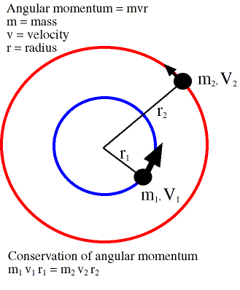
Earth wobbles because center of mass (CM) is on different axis than rotation
Rotational axis in space is controlled entirely by interplanetary interactions
Any mass redistribution on planet relocates location of CM

Slide 3
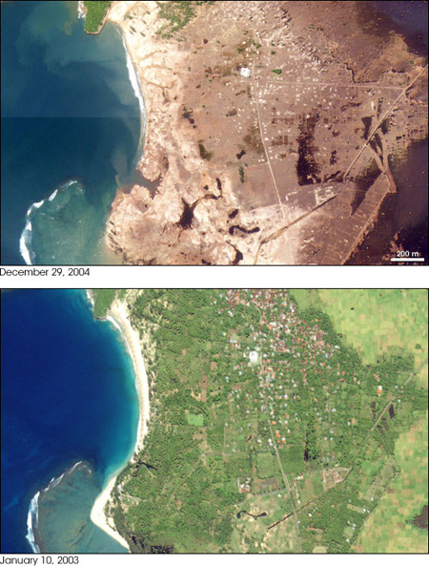
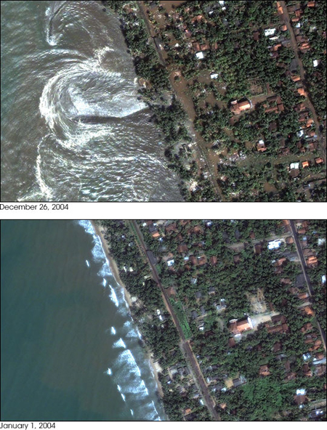
Coseismic Deformation

Slide 4
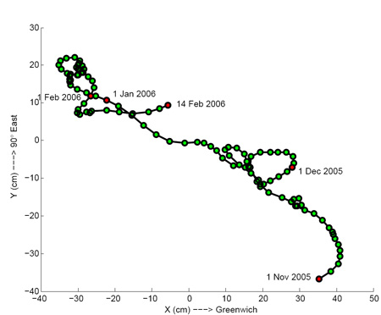
History
Location | Date | Magnitude | Change in LOD | CM axis shift
Chile | 2010-2-27 | 8.8 | -1.26 µs | 8 cm
Sumatra | 2004-12-26 | 9.1 | -6.8 µs | 7 cm
Japan | 2011-3-11 | 8.9-9.0 | -1.8 µs | 17 cm
Indonesia | 2004* | 9.0* | -2.68 µs | 2.5 cm*
Chile | 1960-5-22 | 9.5 | -8.0 µs | 2 cm*
CM axis shift* in Pole Position, not figure axis
Figure axis ~ 10 m offset from rotation axis
Trend in figure axis movement ~ 140° E
24 hours = 86,400,000 µs
LOD varies ~ 1,000 µs per year

Slide 5
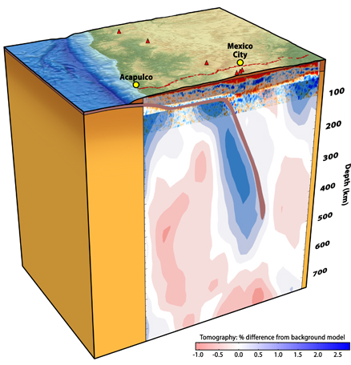
Magnitude does not indicate change in CM, also independent of change in LOD
Subduction angle, and rupture depth have significant effect on mass relocation
Steep subduction produces slab interaction at core-mantle boundary, site of rotational effects

Slide 6
Magnitude does not indicate change in CM, also independent of change in LOD
Shallow, continental subduction (convergence) relocates mass that tends to be less dense than oceanic crust
Continental subduction has less effect on redistribution of CM

Slide 7
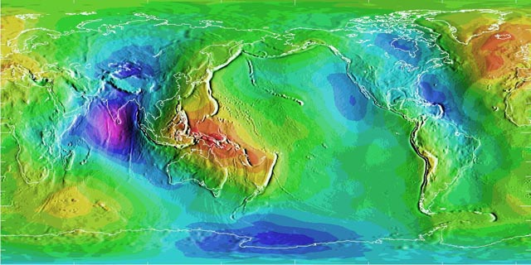
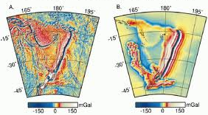
Plate convergence produces clear signal in geoid and gravity anomaly

Slide 8
Magnitude does not indicate change in CM, also independent of change in LOD
Oblateness of reference ellipsoid, and geoid, control moment of inertia
Coseismic displacement moves ellipsoid toward less oblateness
Latitude of event has greater effect on LOD than magnitude
Mid-latitude events have greatest effect

Slide 9
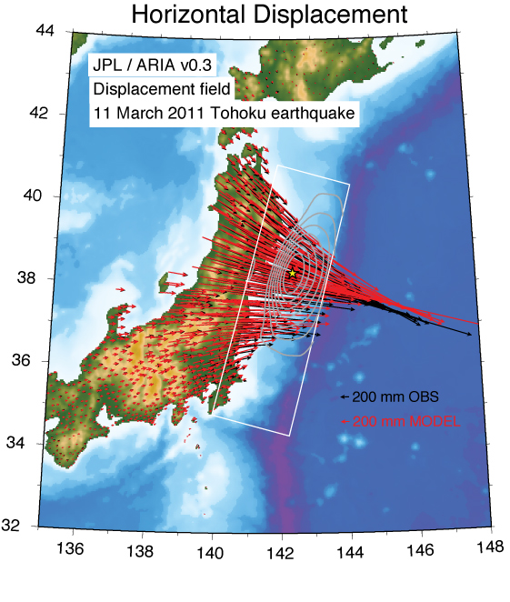
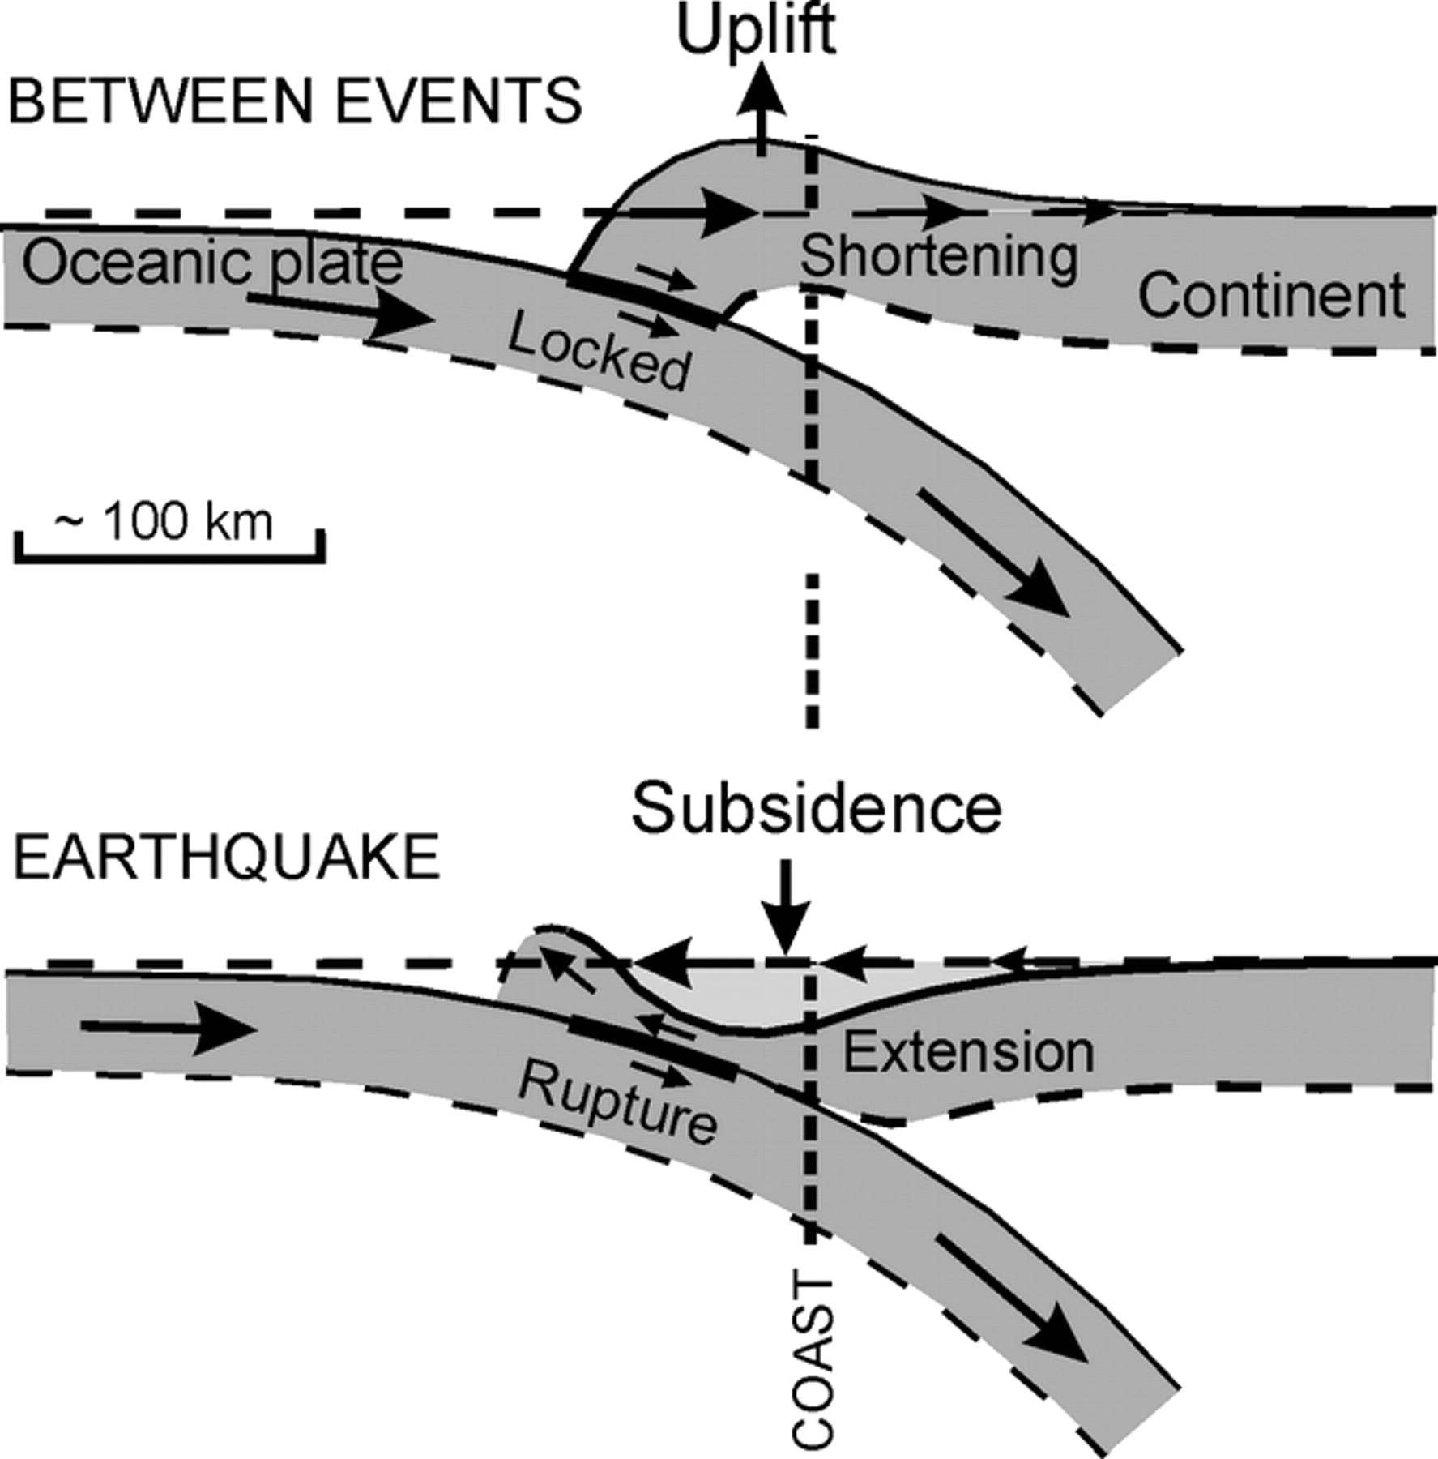
Shift in figure axis vs. displacement
Japan earthquake shifted figure axis ~17 cm
Coseismic displacement of Japan ~2.4 m

Slide 10
Long period changes to LOD
Changes in moment of inertia at CMB
Post glacial rebound
Post-seismic deformation augments coseismic
Pre-seismic deformation is slow counteraction
Mass transport, at surface and depth
Seasonal mass changes in atmosphere, cryosphere, hydrosphere, and on land
Long period tidal effects
Average annual total change in LOD ~ 1 my⁻¹

Slide 11
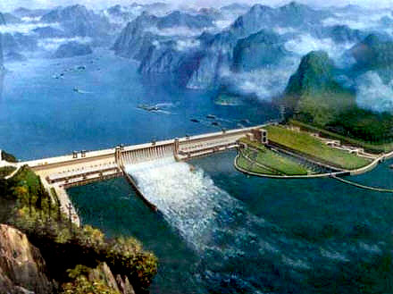
Long period changes to LOD
Post glacial rebound ~10 mmy⁻¹, -0.7 µs(cy)⁻¹ LOD, 1° ma⁻¹ shift in figure axis
Three Gorges dam will hold 40 km³, +0.06 µs LOD, 2.0 cm pole shift

Slide 12
Observing changes in LOD
GRACE can observe long period changes
Short period, coseismic displacement has small effect that is calculated
Geoid is effected by mass distribution, changing with shifts in figure axis
Free oscillating harmonics change with material distribution

Slide 13
Summary
Coseismic deformation redistributes mass on a short time period, lowering Earth’s moment of inertia and increasing rotational velocity
All other mass shifts produce greater change, but both positive and negative
Greatest seismic effects on LOD occur when slab interacts with CMB

